Slide 1
6-UNIX System Calls
(The Linux Program Interface,
our text, Chapter 3)

Slide 2
System Calls
Operating systems offer processes running in User Mode a set of interfaces to interact with hardware devices such as the CPU, disks, and printers.
Unix systems implement most interfaces between User Mode processes and hardware devices by means of system calls issued to the kernel.
A system call is an explicit request to the kernel made via a software interrupt.

Slide 3
System Call Examples
Create a new process
Perform I/O
Create a pipe for inter-process communications
Send/Receive signals

Slide 4
System Calls
You can see the whole list of system calls by typing:
> man syscalls
From a programming point of view, invoking a system call looks much like calling a C function.
However behind the scenes, many steps occur!

Slide 5
General Points about System Calls
It changes the processor state from user mode to kernel mode, so that the CPU can access protected kernel memory
The set of system calls is fixed
Each call has a unique number
Programmer identifies the call by name
It may have a set of arguments that specify information to be transferred from user space to kernel and vise versa

Slide 6
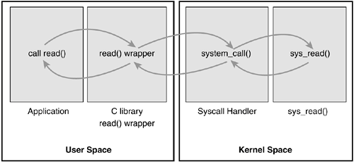
Execution Flow of a System Call
When a User Mode process invokes a system call, the CPU switches to Kernel Mode and starts the execution of a kernel function.
It is a jump to an assembly language function called the system call handler.

Slide 7
What is a wrapper function?
A wrapper function is a subroutine in a software library or a computer program
Main purpose is to call a second subroutine or a system call with little or no additional computation
It provides an interface (prototype) to the outside.
It provides a mapping from the interface to the actual system call on the inside.

Slide 8
From a Wrapper Routine to a System Call
Unix systems include several libraries of functions that provide APIs to programmers.
API = Application Program Interface
Some of the APIs defined by the libc standard C library refer to wrapper routines (routines whose only purpose is to issue a system call).
Usually, each system call has a corresponding wrapper routine, which defines the API that application programs should employ.

Slide 9
The Return Value of a Wrapper Routine
Most wrapper routines return an integer value, whose meaning depends on the corresponding system call.
A return value of -1 usually indicates that the kernel was unable to satisfy the process request.
A failure in the system call handler may be caused by
invalid parameters
a lack of available resources
hardware problems, and so on.
The specific error code is contained in the errno variable, which is defined in the libc library.

Slide 10
Execution Flow of a System Call
When a User Mode process invokes a system call, the CPU switches to Kernel Mode and starts the execution of a kernel function.
It is a jump to an assembly language function called the system call handler.

Slide 11
System Call Number
Because the kernel implements many different system calls, the User Mode process must pass a parameter called the system call number to identify the required system call.
The eax register is used by Linux for this purpose.
Additional parameters are usually passed when invoking a system call.
See: On Athena, /usr/include/asm/unistd_32.h for listing of system calls (32 bits)

Slide 12
The Return Value of a System Call
All system calls return an integer value.
The conventions for these return values are different from those for wrapper routines.
In the kernel
positive or 0 values denote a successful termination of the system call
negative values denote an error condition
In the latter case, the value is the negation of the error code that must be returned to the application program in the errno variable.
The errno variable is not set or used by the kernel. Instead, the wrapper routines handle the task of setting this variable after a return from a system call.

Slide 13
Operations Performed by a System Call Handler
The system call handler performs the following operations:
Saves the contents of most registers in the Kernel Mode stack.
This operation is common to all system calls and is coded in assembly language.
Handles the system call by invoking a corresponding C function called the system call service routine.
Exits from the handler:
The registers are loaded with the values saved in the Kernel Mode stack
The CPU is switched back from Kernel Mode to User Mode.
This operation is common to all system calls and is coded in assembly language.

Slide 14
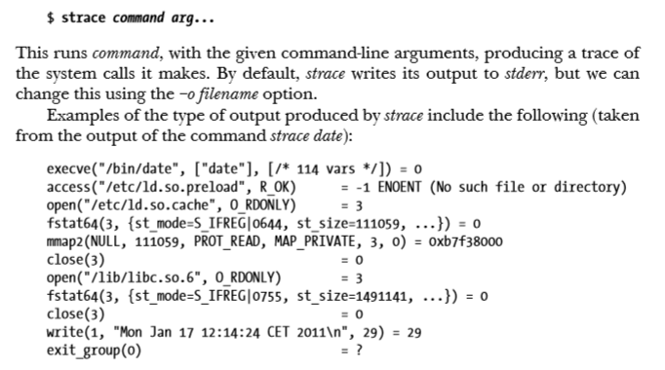
Tracing System Calls – strace command (See Appendix A in LPI, page 1401)

Slide 15
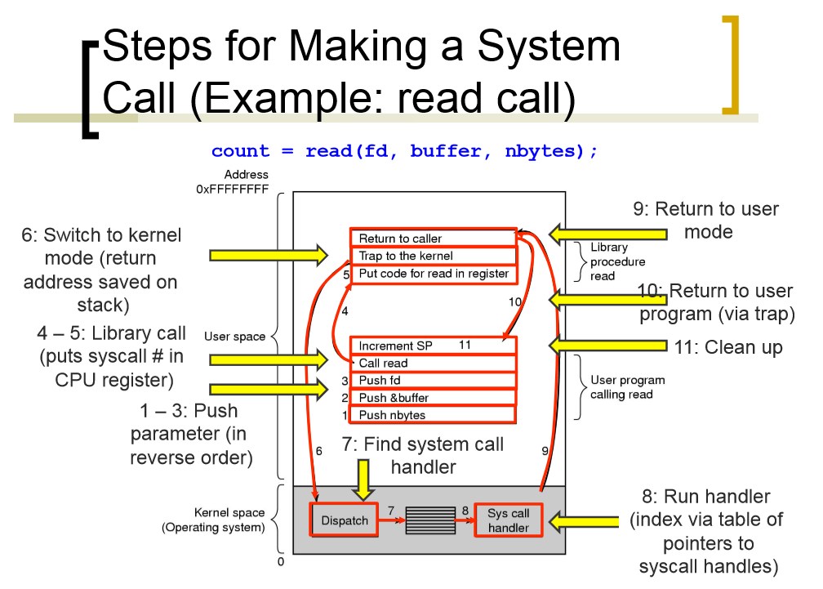
Source: University of Illinois CS 241 Staff
sys_call_table

Slide 16
Wrapper:
Move parameters from the user stack to processor registers
Switch to kernel mode and jump to the system call handler
Post-process the return value and compute errno
C program:
count = read(fd, buffer, nbytes);
System Call Handler:
Save processor registers into the kernel mode stack
Call the service function in the kernel
(Linux: array of function pointers indexed by system call number )
Restore processor registers
Switch back to user mode
Call processor-specific instruction
Source: University of Illinois CS 241 Staff
sys_call_table

Slide 17
6-UNIX System Calls The End
(The Linux Program Interface
our text Chapter 3)

